Slide 1






02.06.2025
FROM SUNDARBANS TO THE WORLD: EVALUATING CLIMATE CHANGE ON THE GROUND
www.glocalevalweek.org
www.tdh-india.org

Slide 2
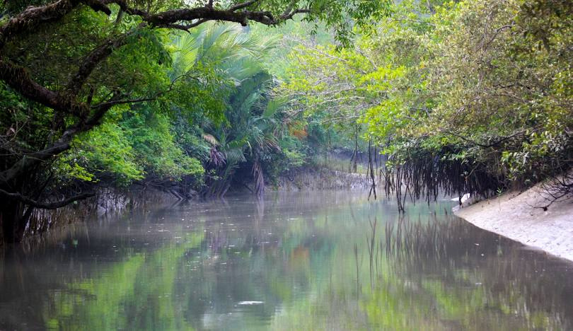




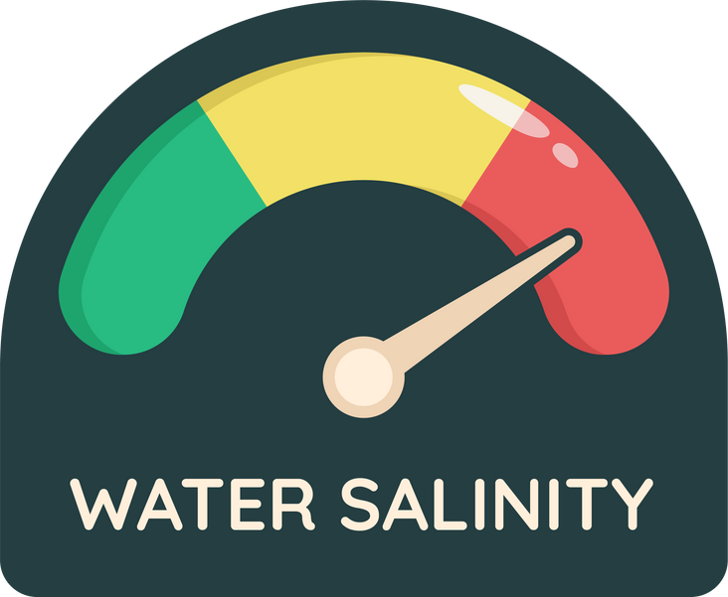


About Sundarbans
Sundarban Region
A Shared Delta
Islands of Life
The world’s largest delta, faces extreme vulnerability to climate change.
Delta formed by Ganga-Brahmaputra-Meghna, shared by Bangladesh and India.
Indian Sundarbans comprises of 102 islands: 48 forested, 58 inhabited by 4.5 million people.
Climate Vulnerabilities in the Sundarbans:
Sea-Level Rise: ~0.30m rise between 1950–2014 causing severe land erosion
Salinization: Tidal seawater intrusion increases river salinity, affecting freshwater ecosystems
Biodiversity & Habitat Loss: Salinity threatens Sundari trees; shrinking habitats escalate human-wildlife conflict
Frequency of severe cyclonic storms: 26% increase in the frequency of severe cyclones (1975–2006) in Bay of Bengal

Slide 3
IMPACT OF CLIMATE CHANGE:
A THREAT MULTIPLIER

Slide 4
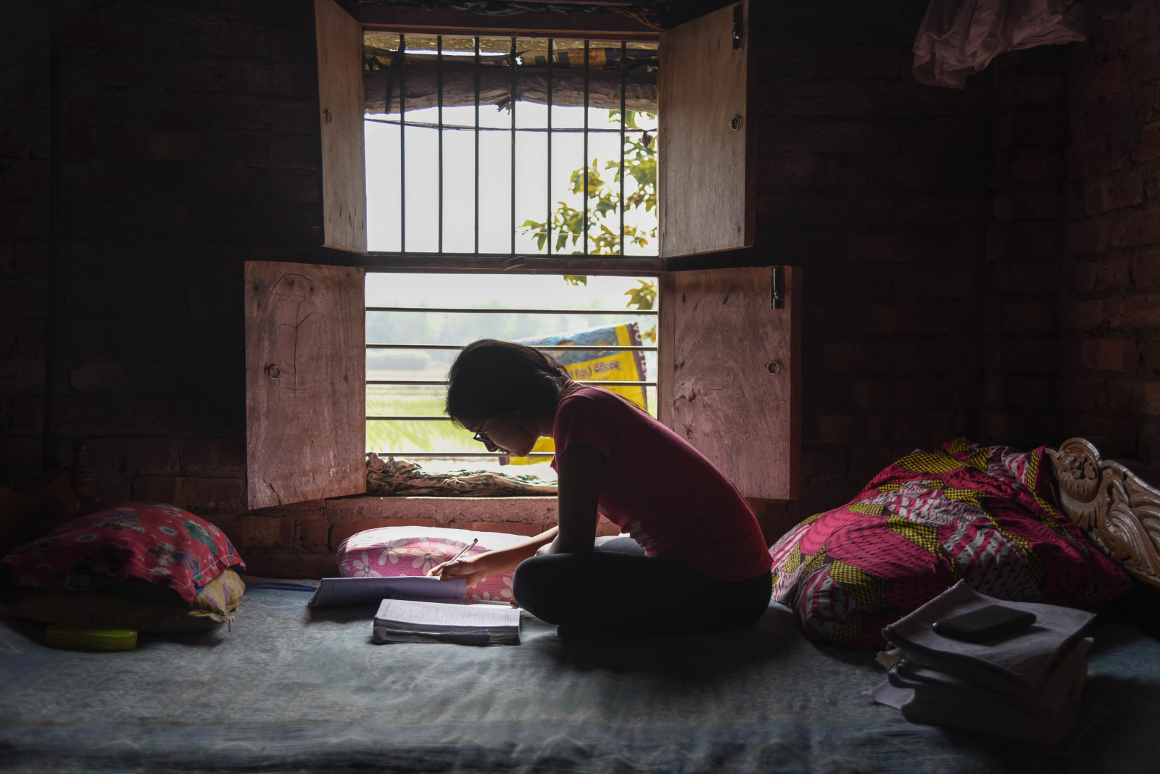
Migration
60% of households report atleast one member to have migrated
Three predominant types of movement:
  Climate-related push factors: Predominantly temporary circular migration, averaging ~8 months duration.
  Disaster-Induced Displacement: 79% of households report relocating to higher ground shelters during extreme weather events.
  Permanent Relocation: Families moving from eroding islands (e.g., Ghoramara) to safer ones like Sagar Island.
Push Factors
Key Drivers: Decreased agricultural productivity/fishing and increased landlessness
Unsafe Migration: 87% rely on middlemen, employed in informal and unregulated sectors with poor working conditions and legal protections.
Community Perception: 71% want to stop migrating due to social disconnect and vulnerability.

Slide 5
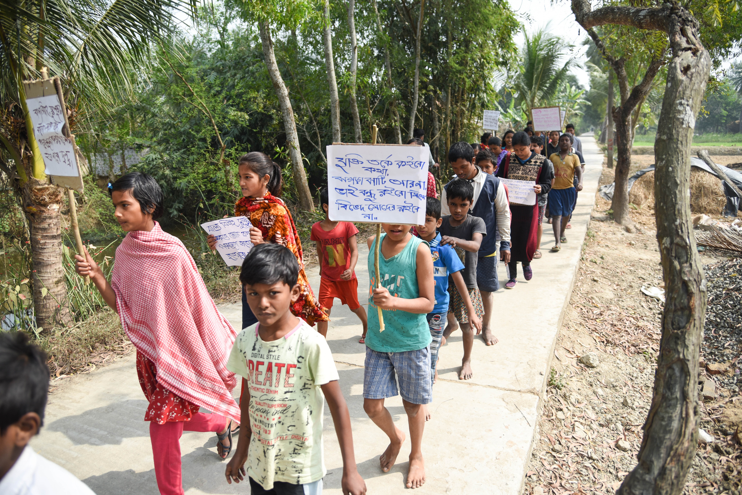
Child Protection
Out of Class, Out of Reach: Children at Risk in the Sundarbans
  Education Disrupted: 70% report irregular attendance; 27% drop out post-disasters.
  Child Labour Pressure: 14% face family pressure to engage in paid work after disasters.
  Impact on Psychosocial Wellbeing: Children face fear, loss, and uncertainly, during disasters.
  Lack of Safety Nets and Protection Systems: Defunct child protection mechanisms, only 11% of children approached child protection actors during disasters.
  Children left behind by migrating parents: Experience a range of emotional, psychological and developmental challenges.
Unsafe Childhoods
6. Violence Against Children: Harsh disciplining and neglect rise with household migration and school closures.
7. Early Marriage & Elopement: Triggered by parental disconnect, emotional repression, and lack of future prospects.

Slide 6
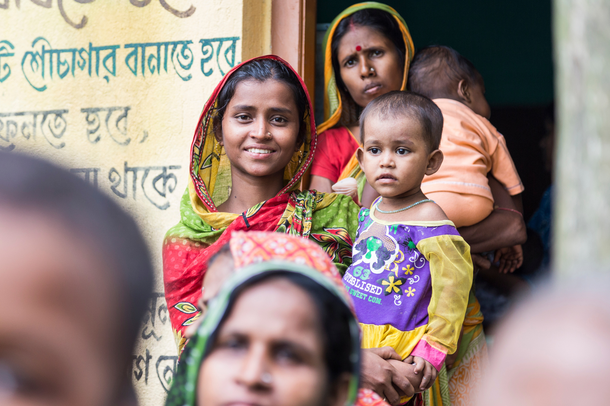
MNCH
Born into the Storm: Maternal & Child Health in a Climate-Crisis Zone
  High Risk Pregnancies: 47% women showed high-risk pregnancy symptoms; ~10% had spontaneous abortions.
  Disaster Impact: 95% pregnant women reported facing psychological stress, food insecurity, and poor access to health/WASH facilities.
  Adolescent Health: 97% of adolescents reported menstrual hygiene was compromised during disasters.
Nutrition & Access to Care
Child Nutrition: 22% newborns had low birth weight; High rates of malnutrition with 38.5% households reporting inadequate food intake.
Access to Healthcare: 34% villages travel over 10 km for treatment, worsened during floods/cyclones.

Slide 7


global
evaluation
initiative
Localization Platform of Tdh
Thank you!
www.glocalevalweek.org
www.tdh-india.org

