Slide 1
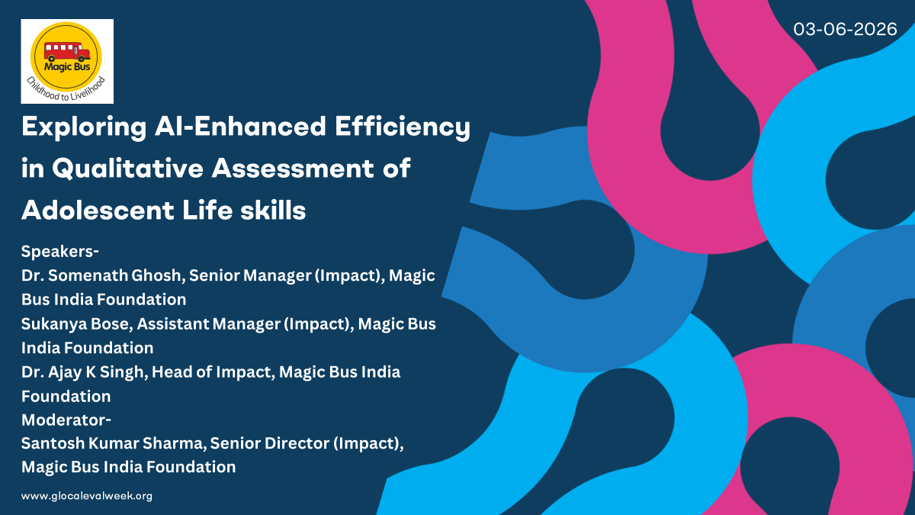
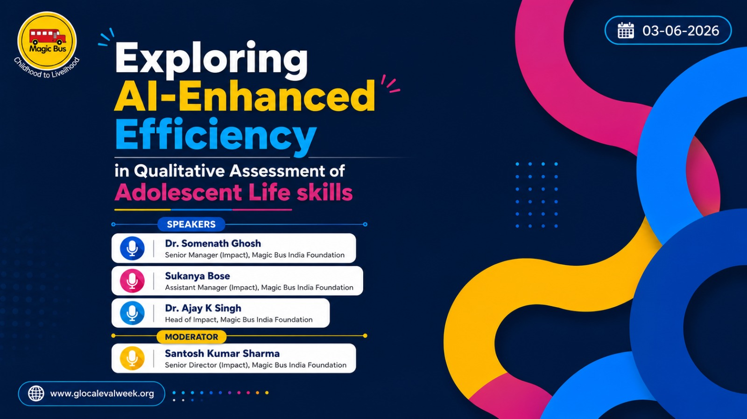

Slide 2
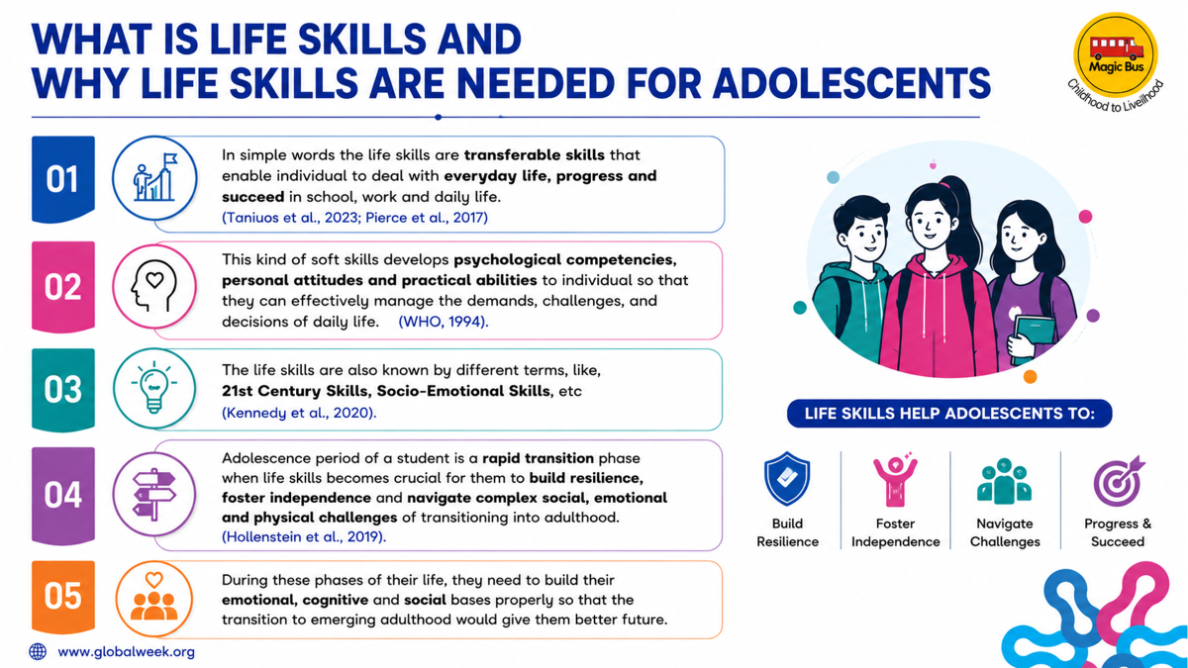

Slide 3
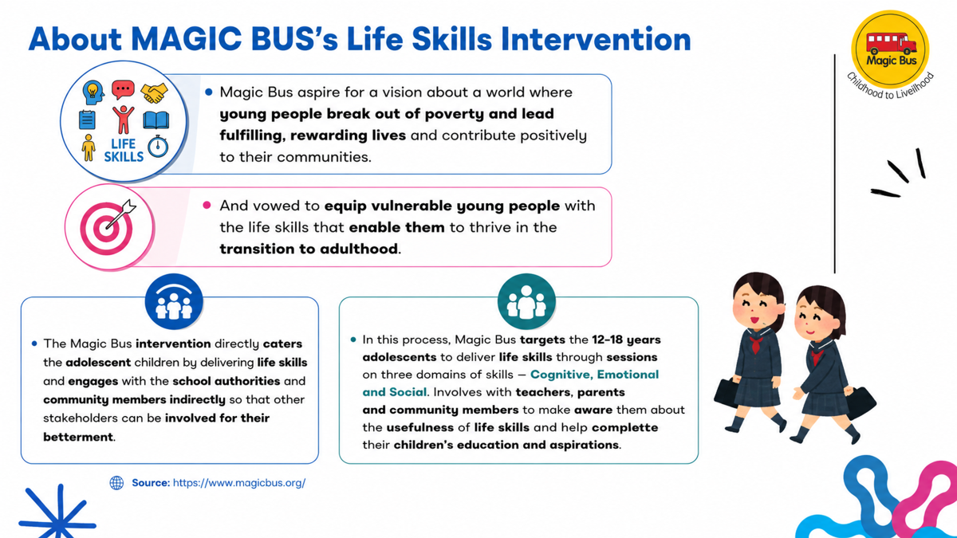

Slide 4
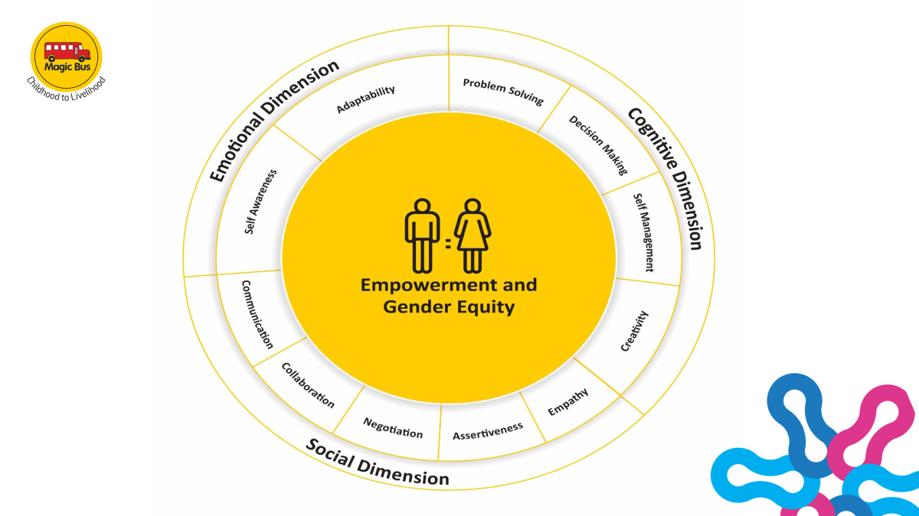
Snapshot of Magic Bus’s Life Skills Curriculum

Slide 5
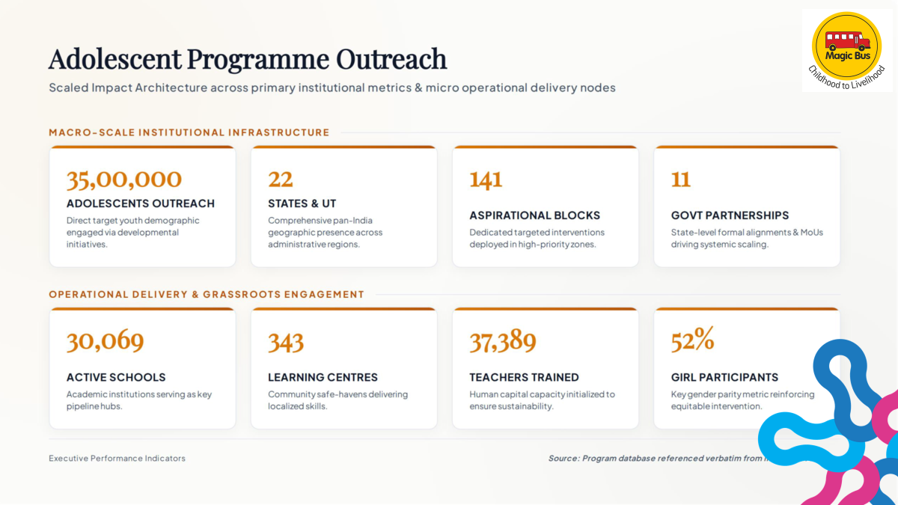
Magic Bus India Foundation

Slide 6


What is qualitative field assessment in life skills and why does it matter?

Slide 7
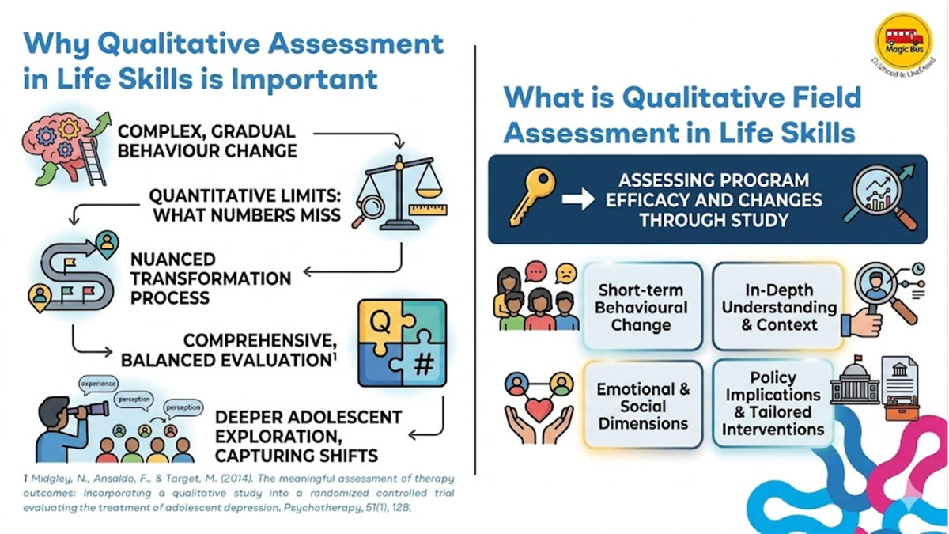

Slide 8
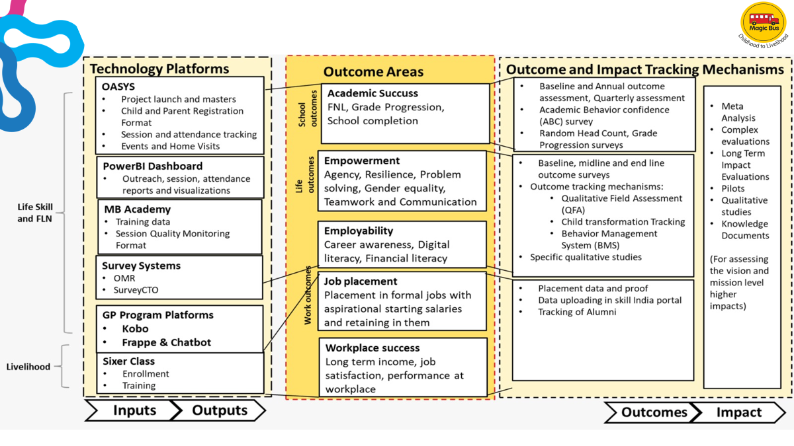
Magic Bus’s Monitoring and Evaluation system: Board Architecture

Slide 9
Process for conducting Qualitative Field Assessments

Slide 10
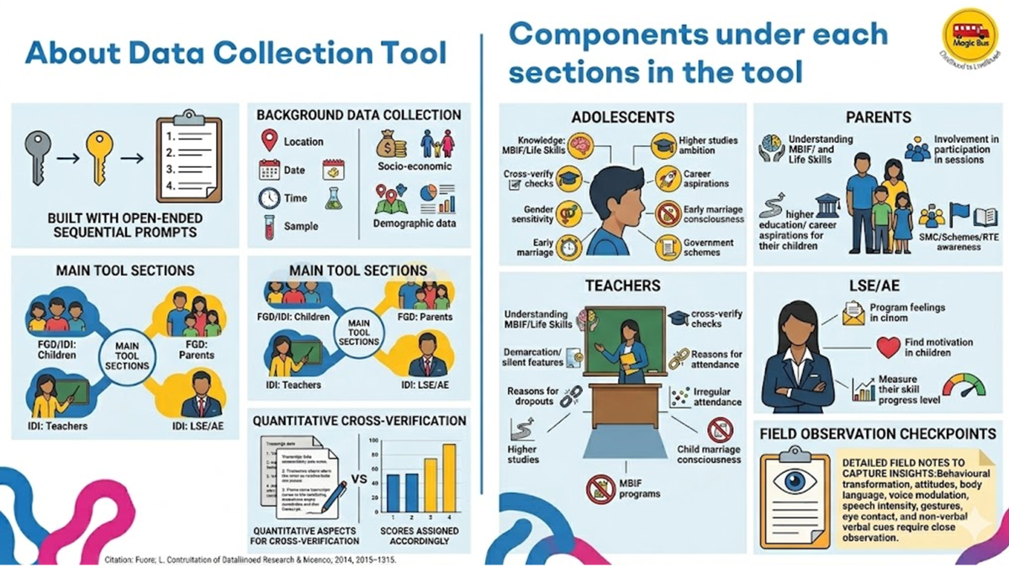

Slide 11
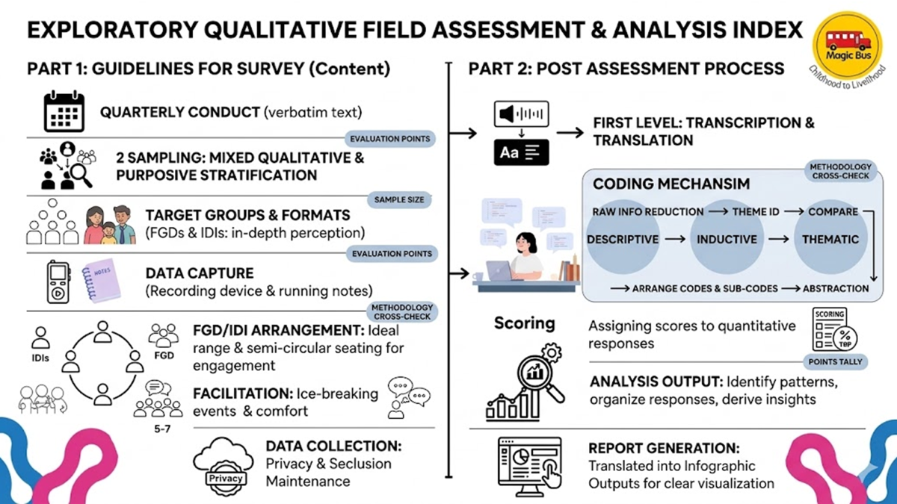

Slide 12
Integration of AI tool in the Qualitative Field Assessment Process

Slide 13
Challenges of applying qualitative field assessment (without using AI) for evaluating adolescent’s Life Skills
  Conducting a qualitative assessment manually requires a significant amount of time, as the process is extensive and resource intensive.
  At times, the sheer volume of transcriptions and coding makes it challenging to clearly segregate themes from the ground up.
  Additionally, human intervention can introduce bias in perception, affecting the objectivity of the analysis.
How AI applications are helpful in the process
  It helps reduces the step of transcribing the field level information manually captured through the audio recording
  It helps to prepare and segregate the transcribed data into theme wise scripts. It help reduce the step of preliminary coding and sub coding of the transcription manually. However, in-depth coding and sub-coding involves manual involvement
  AI also help reduce the time of preparing the tenacious report. With precise and appropriate prompt, the AI helps to generate infographic slides aligning with the reporting need.

Slide 14
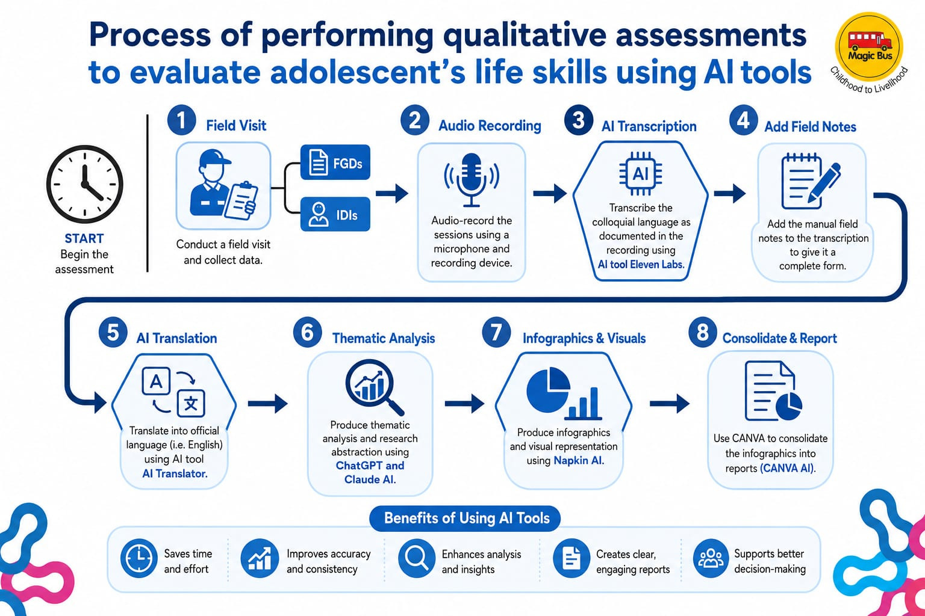

Slide 15
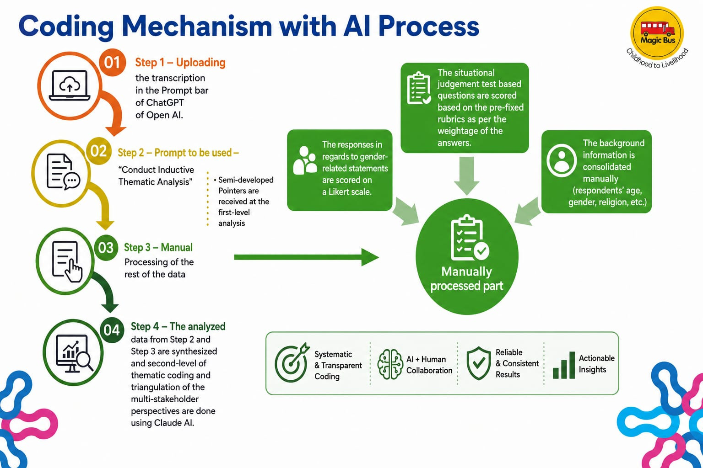

Slide 16
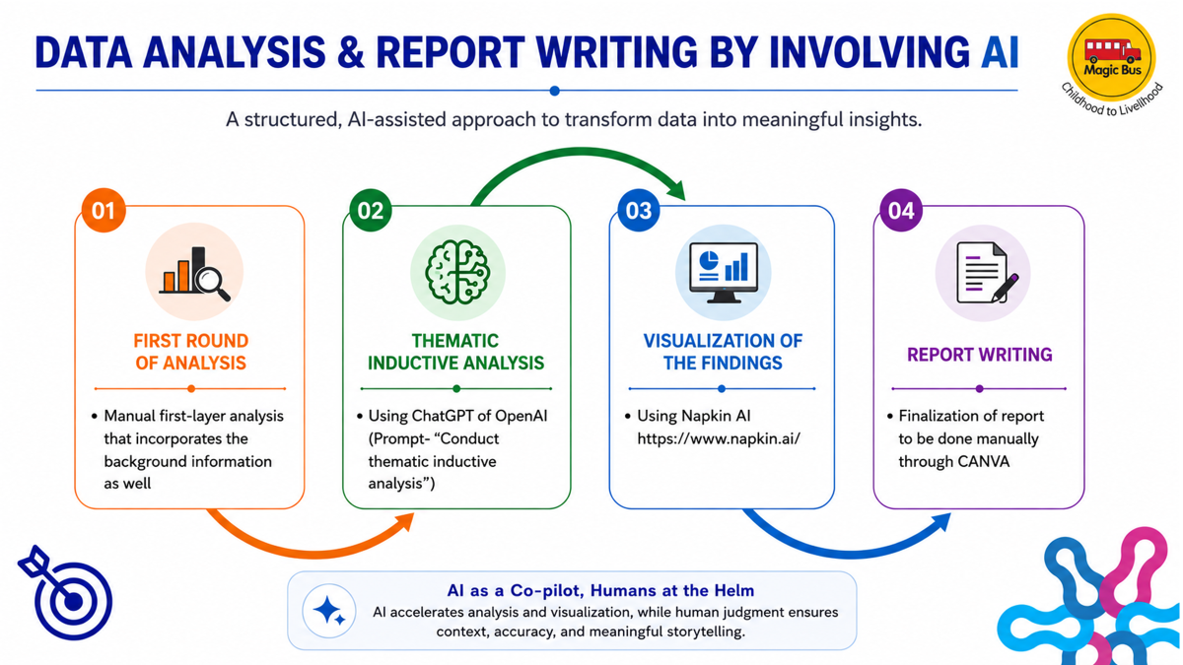

Slide 17
Demo of integrating AI tools into qualitative field assessments for life skills

Slide 18
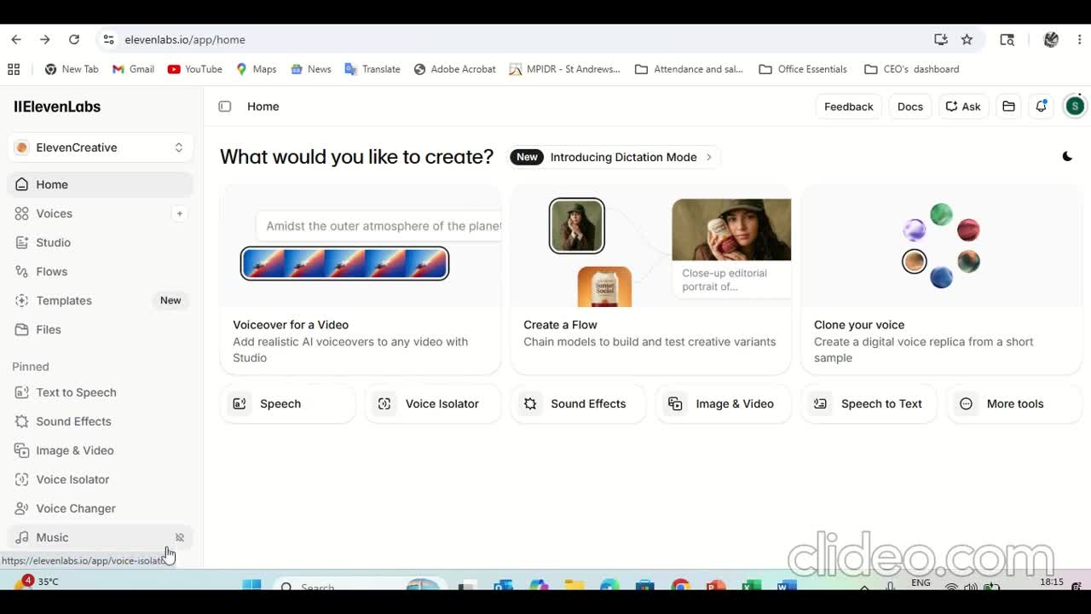

Slide 19
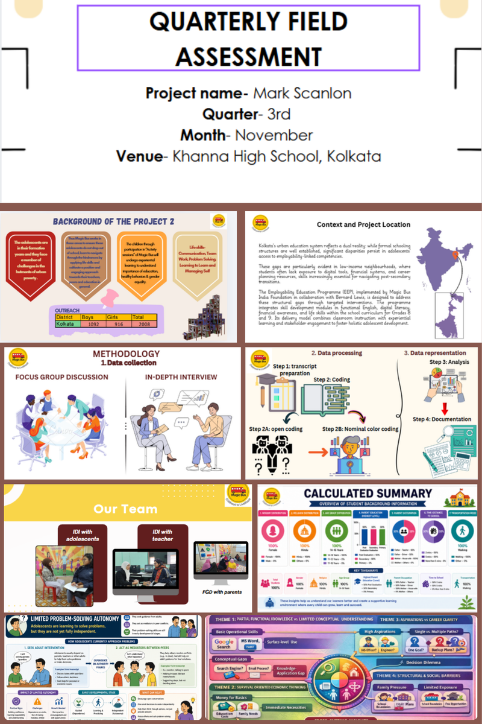
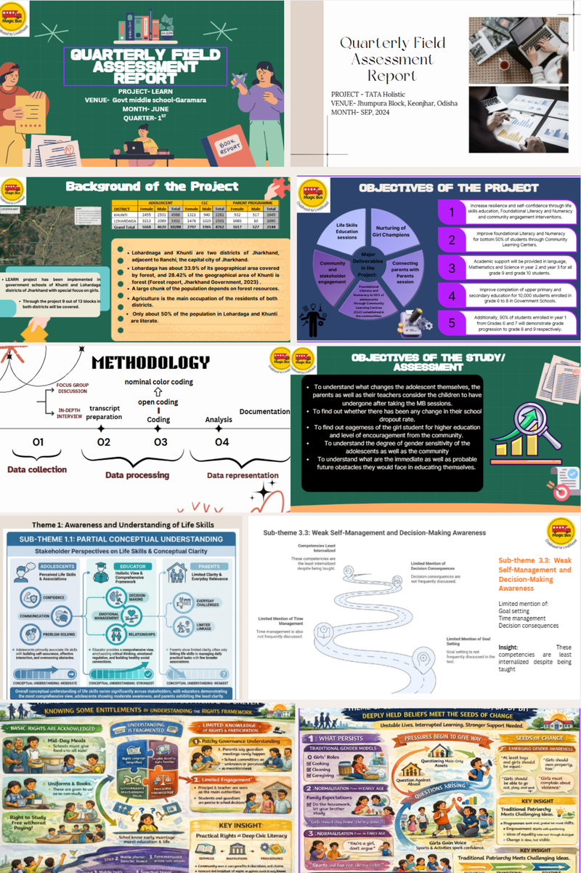

Slide 20
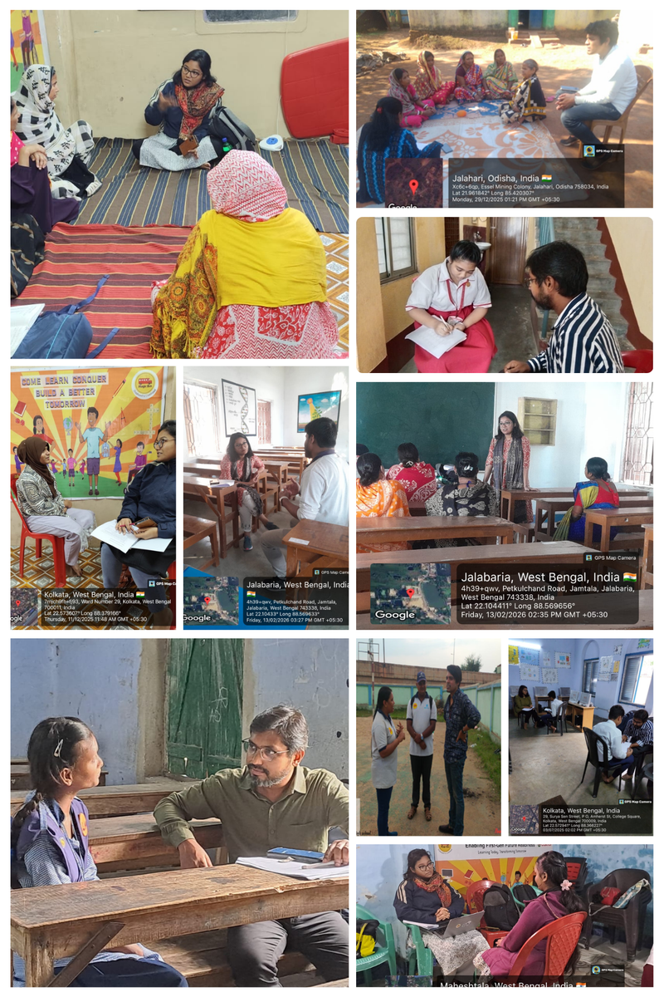
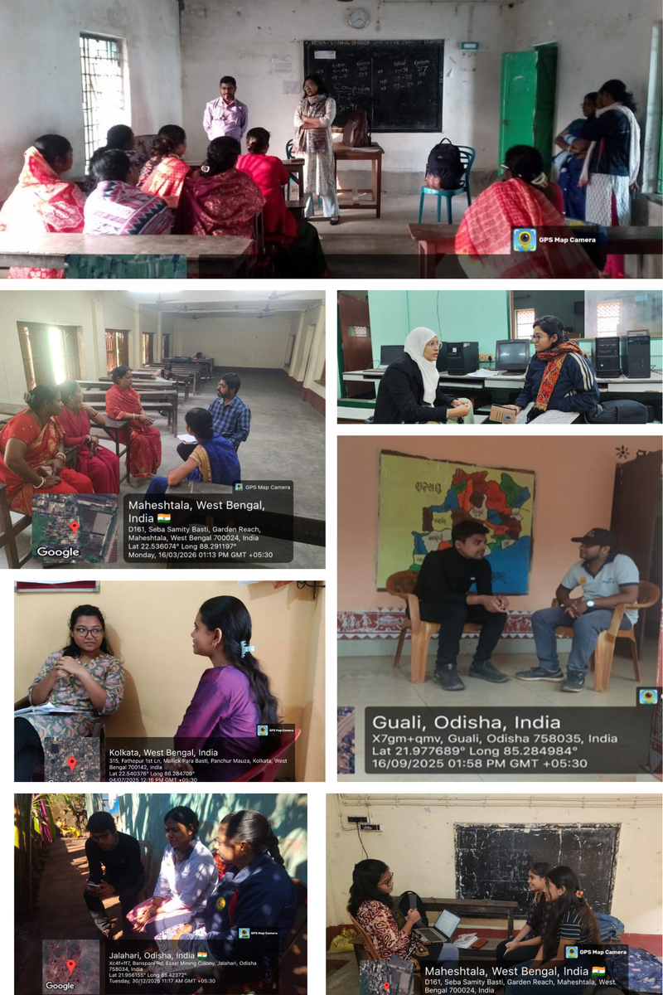

Slide 21
Benefits, Challenges and Learnings from using AI Applications

Slide 22
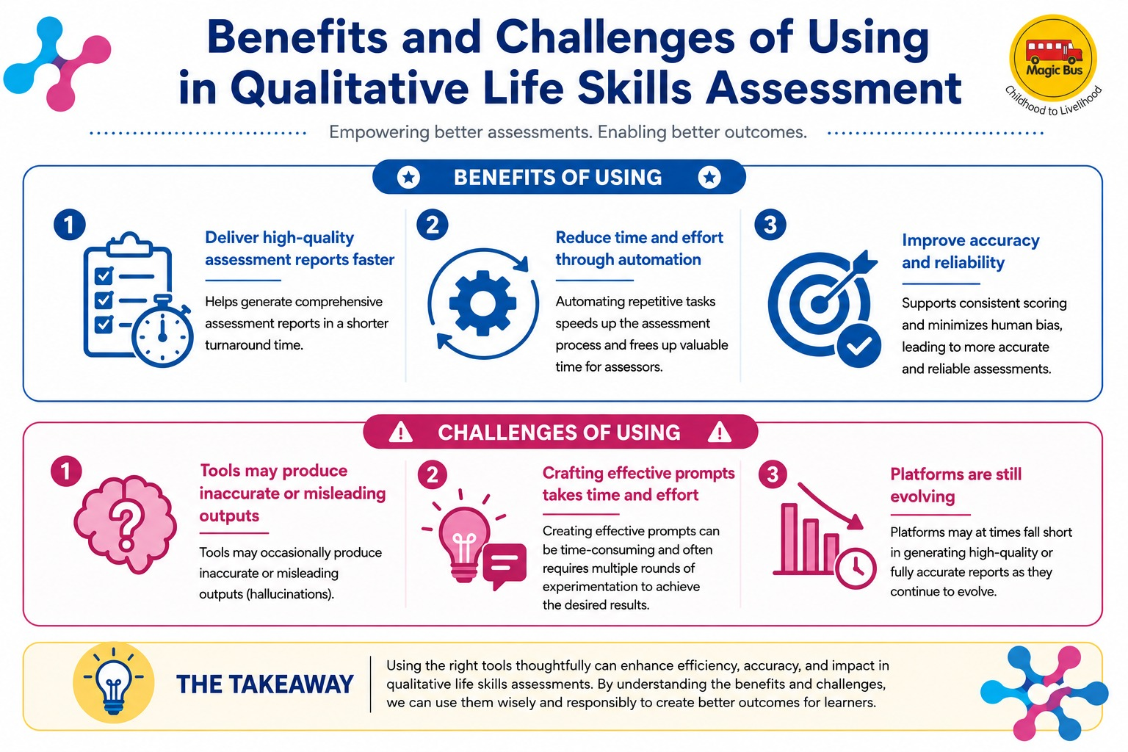
Benefits of Using AI application in the process of Qualitative Life Skills Assessment
  Deliver a high-quality assessment report within a shorter turnaround time.
  Reduce the time and effort required for assessments through automation of processes.
  Improve the accuracy and reliability of the assessment process.
Challenges of using AI Applications
  AI tools may occasionally produce inaccurate or misleading outputs (hallucinations).
  Crafting effective prompts can be time-consuming and often requires multiple rounds of experimentation to achieve the desired results.
  As AI platforms are still evolving, they may at times fall short in generating high-quality or fully accurate reports.

Slide 23
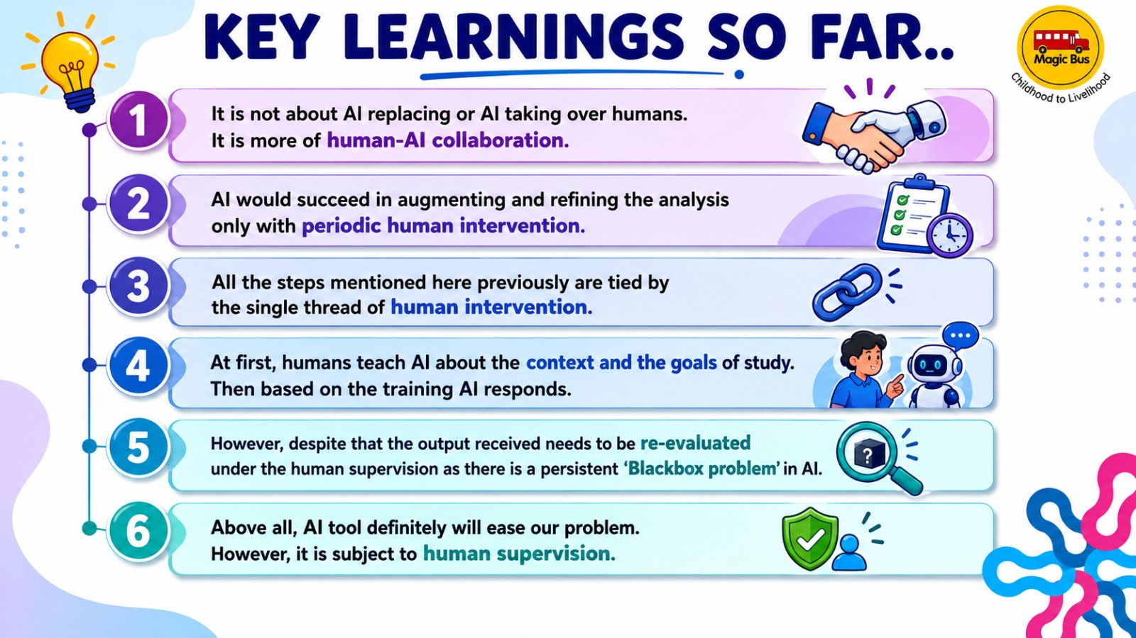

Slide 24
References
Tanious, R., Gérain, P., Jacquet, W., & Van Hoof, E. (2023). A scoping review of life skills development and transfer in emerging adults. Frontiers in psychology, 14, 1275094. https://doi.org/10.3389/fpsyg.2023.1275094
Pierce, S., Gould, D., & Camiré, M. (2017). Definition and model of life skills transfer. International Review of Sport and Exercise Psychology, 10(1), 186–211. https://doi.org/10.1080/1750984X.2016.1199727
World Health Organization. (1994). Life skills education for children and adolescents in schools. Pt. 1, Introduction to life skills for psychosocial competence. Pt. 2, Guidelines to facilitate the development and implementation of life skills programmes (No. WHO/MNH/PSF/93.7 A. Rev. 2). World Health Organization.
Kennedy, Teresa J., and Cheryl W. Sundberg. "21st century skills." Science education in theory and practice: An introductory guide to learning theory. Cham: Springer International Publishing, 2020. 479-496.
Hollenstein, Tom, and Tiffany Tsui. "Systems in transition: The adolescent phase transition." Psychosocial development in adolescence. Routledge, 2019. 17-31.
Midgley, N., Ansaldo, F., & Target, M. (2014). The meaningful assessment of therapy outcomes: Incorporating a qualitative study into a randomized controlled trial evaluating the treatment of adolescent depression. Psychotherapy, 51(1), 128.
https://youtu.be/5t9B_r8pcEc?si=K_QpZaeIm8jnYolG

Slide 25

global
evaluation
initiative
Thank you!
www.glocalevalweek.org

