Slide 1

02-06-2026
Psychometrics serving M&E: Do floor effects in Standardized tests explain the performance of Colombian students?
Claudia Patricia Ovalle,PhD
Claudia.Ovalle@udea.edu.co
www.glocalevalweek.org

Slide 2
Introduction
In educational and psychological tests, a floor effect occurs when test items are so difficult that examinees cannot answer the easiest questions, thus leading to an underestimation of their abilities (Rutkowski et al., 2019).
In PISA 2022, Colombia obtained average scores in mathematics (383 points), reading (409 points), and science (411 points), which show a decrease compared to 2018 and an evident persistence below the OECD average. Colombia ranked 64th out of 81 countries evaluated on the mathematics test, which was the assessment's focus domain in 2022 (Empresarios por la Educación ExE, 2022).
The present research work reflects on the uses of assessment and its characteristics. For example, do standardized assessments in Colombia also suffer from floor and ceiling effects? How could assessment be improved so that students achieve learning outcomes and are evaluated adequately and fairly?
How do we connect psychometrics with evaluation?
www.glocalevalweek.org

Slide 3
Previous Studies
Previous studies (Carrasco et al., 2023; Rutkowski & Rutkowski, 2021; Rutkowski et al., 2019) have reviewed the difficulties presented by international standardized assessments when making comparisons, for example, between different populations (i.e., cultures or countries)
This is important because standardized assessments must be responsible in terms of establishing the degree of comparability of their results (González & Wiberg, 2017)
The literature has also reported that regional assessments are more accurate than international assessments (Carrasco et al., 2023).
Along these lines, Rutkowski & Rutkowski (2021) demonstrated that in PISA for Developing Countries (PISA-D), considerable floor effects persist despite the introduction of additional "easy items".
Rutkowski et al., (2019) reported that in the Dominican Republic, most students were at level 1A or below in Science (PISA 2015), a region in which only 12 of the 184 items on the science test are found.
Findings imply large gaps in measurement across the competency continuum.
www.glocalevalweek.org

Slide 4
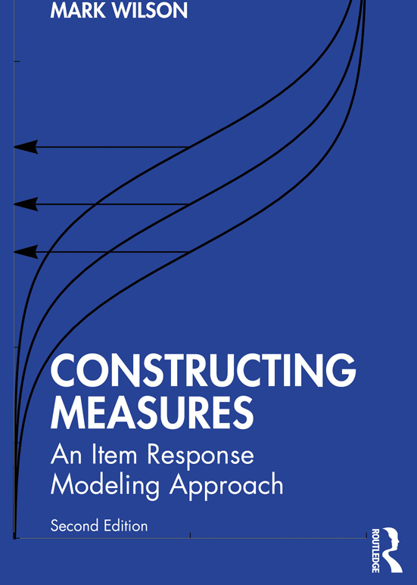
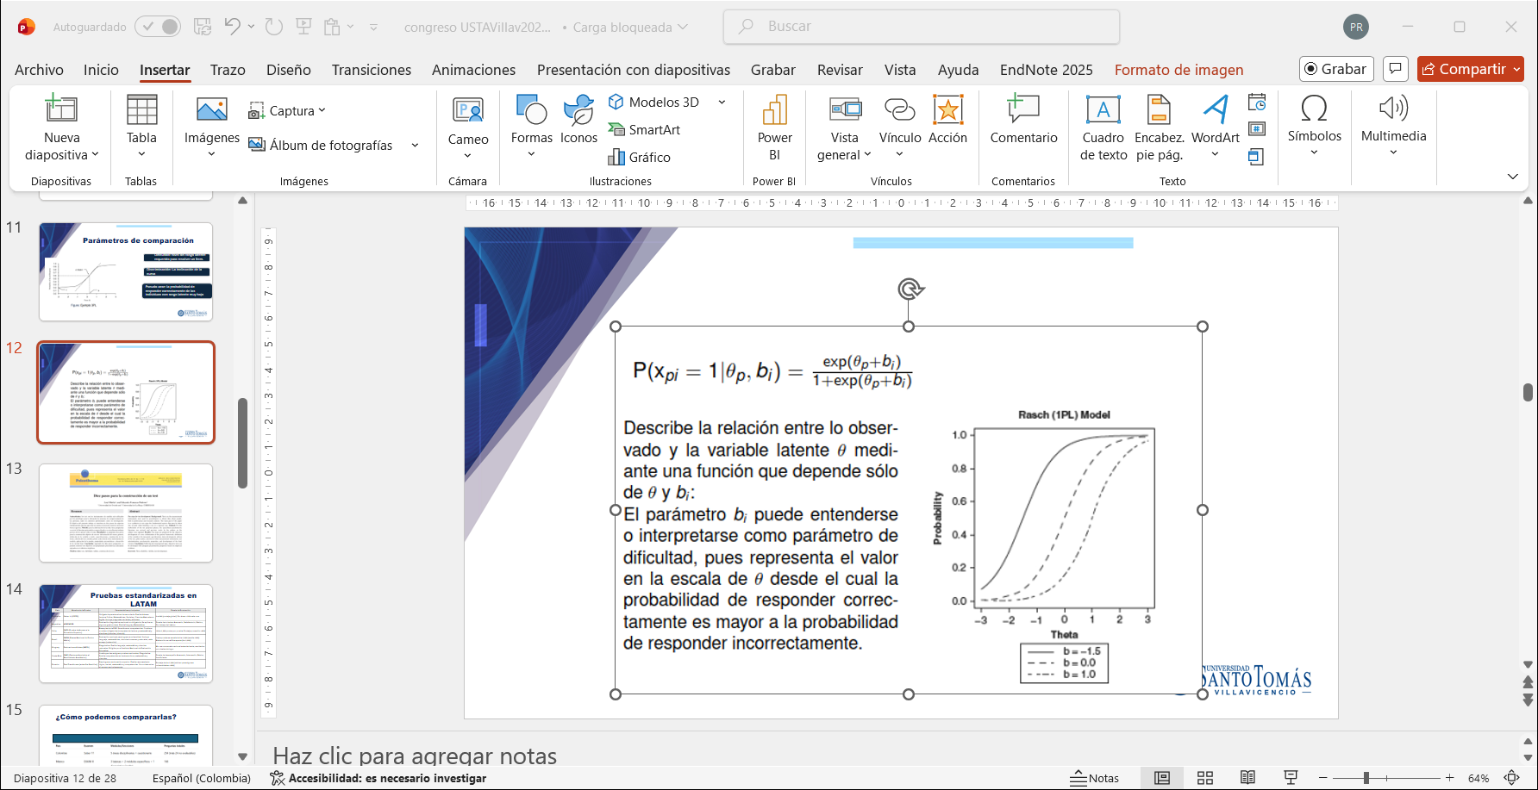
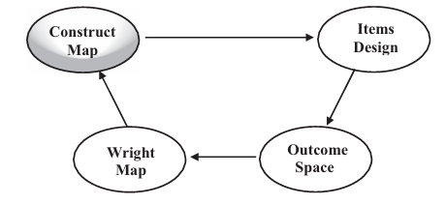
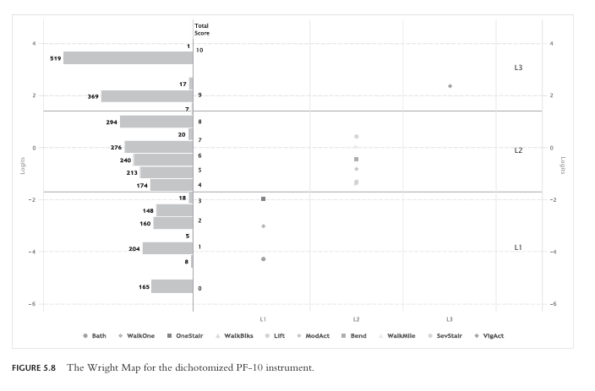
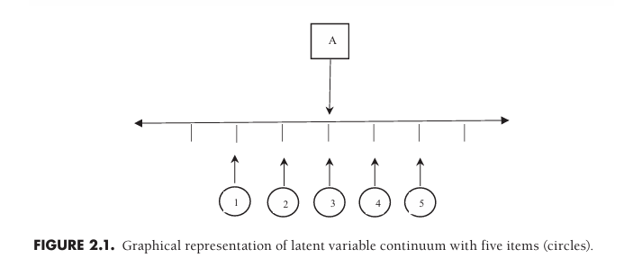
Methodological approach
$$\left.P\left(Y_{ij}=1 \right|θ_{j, }b_{j} \right)= \frac{\exp\left(D\left(θ_{j}− b_{i}\right)\right)}{1+\exp\left(D\left(θ_{j}− b_{i}\right)\right)}$$

Slide 5
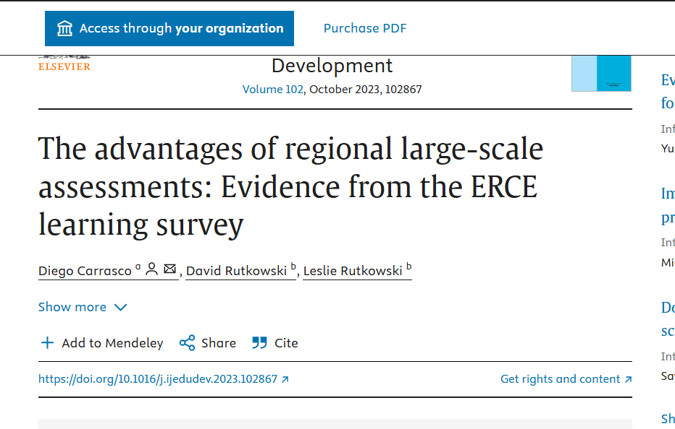
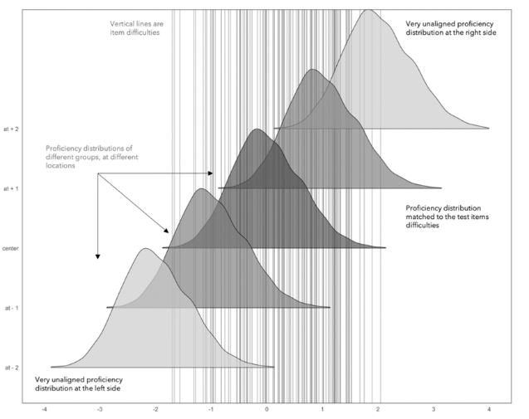
www.glocalevalweek.org

Slide 6
Data & Analysis
This study uses data from the Programme for International Student Assessment (PISA) 2022 public databases. The analysis focuses on Colombian students and includes comparative information from other participating countries. The database corresponds to one of the cognitive test booklets administered in the assessment, which includes a total of 91 dichotomous items.
Sample consists of approximately 7,800 Colombian students who participated in the assessment. PISA employs a complex sampling design that ensures national representativeness, considering stratification variables such as school type and geographic location.
Measurement Model Item response theory (IRT) is a latent variable model in which the probability of a correct response depends on parameters describing the item (De Ayala, 2013; NRC National Research Council, 2001; Rasch, 1960)
Data Analysis The parameters of the resulting items (the difficulty of each item) and the estimates of population achievement (or latent variable theta) are combined in construct maps (by calculating logits) that show the degree to which the examinee's competence is measured in each population and where there may be gaps in measurement due to ceiling effects that ignore higher scores and floor effects that leave out lower performances.
www.glocalevalweek.org

Slide 7
Results
DESCRIPTIVE ANALYSIS
A total of 613,744 students participated in the PISA 2022 test. Colombia participated with 7,804 students, representing 1.3% of the total.
Among the participating Latin American countries are Panama (n=4,544), Peru (n=6,968), Paraguay (n=5,084), El Salvador (n=6,705), Uruguay (n=6,618), Mexico (n=6,288), Guatemala (n=5,100), Costa Rica (n=6,113), and Chile (n=6,488). Each contributed around 1 to 2% of the total population
The country that contributed the highest number of students was Spain, with 5% (n=30,800)
The Colombian sample is composed as shown in Table 1. All selected students took the test on a computer.
Region | Frequency | % | Accumulated %
Colombia: all other | 5818 | 74,6 | 74,6
Colombia: Bogotá | 1986 | 25,4 | 100
Total | 7804 | 100 | 100
www.glocalevalweek.org

Slide 8
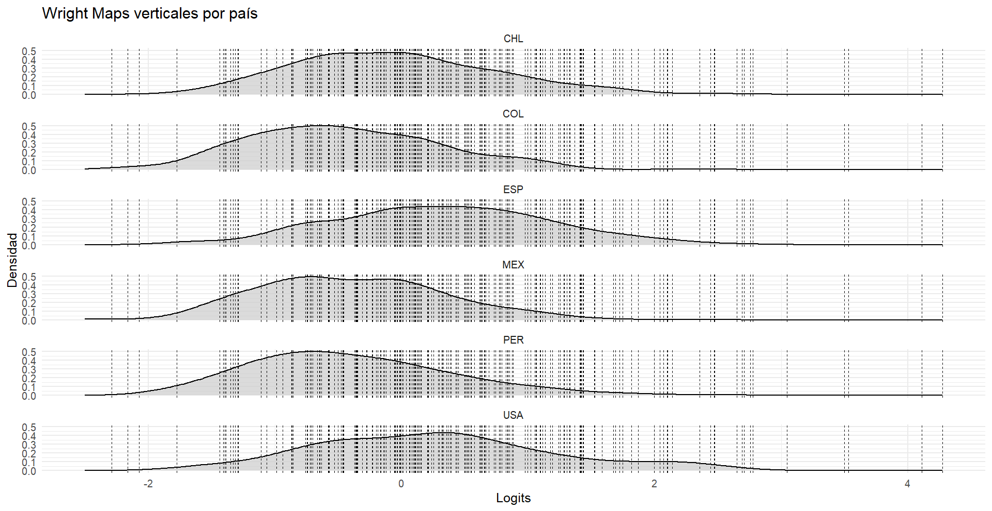
Results
WRIGHT MAPS
The Wright map for six selected Ibero-American countries shows that the ability distribution is concentrated on the easy items (on the left side of the graph). Still, the entire skill range is covered for each of the distributions, using a wide range of different items (i.e., the beta or difficulties of each item represented by vertical dotted lines distributed throughout the densities). The distributions in the figure on the left correspond to the results for CHL (Chile), COL (Colombia), ESP (Spain), MEX (Mexico), PER (Peru), and USA (United States). The distribution of results for Spain tends to be slightly to the right compared to the other distributions.
The results do not evidence a floor effect for Colombia. Most students are located within the range of item difficulties, including the lower end of the scale
Wright's map for items on form 21 (91 items) answered by students from six countries . Source: Prepared by the author
www.glocalevalweek.org

Slide 9
Results
CNTRY | N (Students) | Theta (Mean) | Theta (SD) | Theta (SE)
SGP | 193 | 1,106 | 1,035 | 0,074
JPN | 227 | 1,103 | 0,985 | 0,065
HKG | 172 | 0,954 | 1,077 | 0,082
MAC | 124 | 0,938 | 0,9 | 0,081
TAP | 172 | 0,8 | 1,194 | 0,091
ESP | 912 | 0,317 | 0,859 | 0,028
USA | 170 | 0,264 | 0,928 | 0,071
CHL | 178 | -0,054 | 0,78 | 0,058
MEX | 178 | -0,381 | 0,751 | 0,056
PER | 194 | -0,395 | 0,79 | 0,057
COL | 230 | -0,45 | 0,751 | 0,05
KSV | 235 | -0,799 | 0,629 | 0,041
DOM | 200 | -0,874 | 0,524 | 0,037
SLV | 205 | -0,875 | 0,597 | 0,042
Average latent ability for some countries whose students received form 21
A new one-dimensional Rasch model was estimated where latent abilities (θ) were obtained using EAP estimation for other participating countries. The table on the left, presents the means, standard deviations, and sample sizes per country, all on a common logit scale for latent ability (individual theta parameter). The results are reported in descending order, from the nation with the highest average ability (the highest theta measured in logs) down to the nation with the lowest measure of ability. Latin American countries show the lowest average ability in the scale.
Source: Prepared by the author
www.glocalevalweek.org

Slide 10
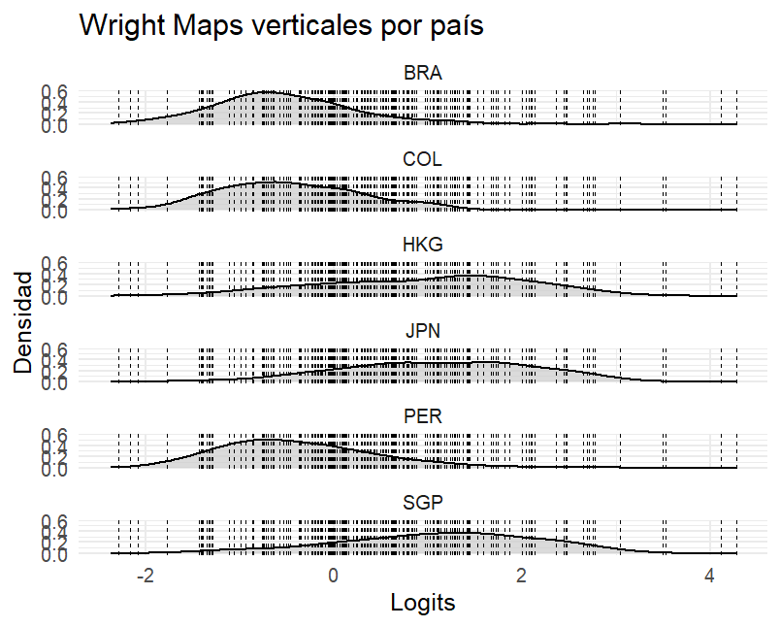
Results
WRIGHT MAPS
High-performing countries such as Japan and Singapore show a concentration of student abilities at the upper end of the scale, exceeding the difficulty of the most challenging items. This pattern indicates ceiling effects for these countries, as the assessment does not fully capture the performance of students with very high ability levels. By contrast, countries with lower average performance levels show ability distributions that are more closely aligned with the distribution of difficulty.
The distributions of Colombia, Peru, and Brazil are concentrated in the easier items to the left of Figure 5. Nevertheless, the distributions of the six countries represented on the map align with the difficulty of the items applied, thus ruling out ceiling or floor effects.
Wright's map for items on form 21 (91 items) answered by students from six countries . Source: Prepared by the author
www.glocalevalweek.org

Slide 11
Results
The “Targeting” parameter
Indicates the difference between the average item difficulty and the average respondents´ ability.
In the case of Colombia, the parameter is negative but tends toward 0, or adequate capacity to evaluate individuals of all performance levels, from the bottom 10% to the top 90%.
As can be seen in Table 3, most differences between ability (individual) and difficulty (item) do not exceed a unit, and the test allows measurement of individuals from different countries regardless of their ability level, since the items (their difficulties) cover all ability levels. This is a characteristic of the high quality of PISA´s test structure.
País | Theta (Mean) | Beta (Mean) | targeting_diff
SLV | -0,88 | 0,43 | -1,30
DOM | -0,87 | 0,43 | -1,30
BRA | -0,52 | 0,43 | -0,95
COL | -0,45 | 0,43 | -0,88
IRL | 0,38 | 0,43 | -0,05
GBR | 0,39 | 0,43 | -0,04
AUT | 0,47 | 0,43 | 0,04
Source: Prepared by the author
www.glocalevalweek.org

Slide 12
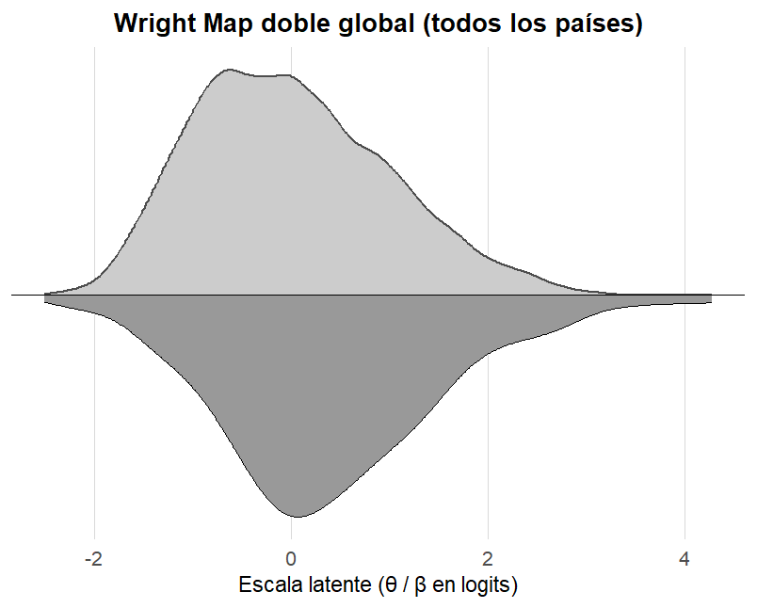
Results
A global Wright map was constructed to examine the overall alignment between people's ability estimates and the difficulty parameters of all items across all participating countries.
There is no evidence of floor effects.
Source: Prepared by the author
www.glocalevalweek.org

Slide 13
Results
A country is an outlier if it has many people outside the item range (more than 10% of those assessed fall outside the difficulty range of the items applied), or its targeting_diff (difference between ability and difficulty) is extreme (person-item indices exceed ±2 standard deviations). Countries marked as outliers are those with |z| values of targeting diff greater than 2 (clearly misaligned country) or percentage outside of the difficulty range is greater than 10%. These indicators are interpreted as serious coverage problems, indicating ceiling or floor effects in the test.
Only two countries show ceiling effects (their extreme abilities cannot be measured due to the difficulty of the items applied). These countries are Japan and Singapore
 | N | theta | beta | Targeting _diff | z_ targeting | outlier_ targeting
JPN | 227 | 1,103 | 0,428 | 0,675 | 2,260 | TRUE
SGP | 193 | 1,105 | 0,428 | 0,677 | 2,265 | TRUE
Source: Prepared by the author
www.glocalevalweek.org

Slide 14
Discussion
The findings of this study suggest that the PISA 2022 assessment does not present floor effects for Colombian students. The Wright maps show that the distribution of student abilities is adequately covered by the range of item difficulties included in the test. This indicates that the assessment can capture performance at the lower and middle levels of the achievement continuum for this population.
These results contrast with findings from previous studies in other low- and middle-income countries, where substantial proportions of students performed below the minimum proficiency levels measured by international assessments (Rutkowski et al., 2019). In the case of Colombia, the alignment between item difficulty and student ability supports the validity of inferences drawn from PISA 2022 results.
However, the analysis also reveals ceiling effects in high-performing countries such as Japan and Singapore. In these cases, student abilities exceed the difficulty of the most challenging items, limiting the assessment’s ability to differentiate among students at the upper end of the performance distribution. This finding highlights an ongoing challenge for large-scale assessments: balancing the need to measure low-performing students accurately while also capturing very high levels of achievement.
www.glocalevalweek.org

Slide 15
Conclusion
This study examined whether floor effects in standardized assessments could explain the performance of Colombian students, using PISA 2022 data and a psychometric approach based on Wright maps. The results indicate that PISA 2022 adequately measures the abilities of Colombian students and does not suffer from floor effects that would undermine the interpretation of results.
The absence of floor effects suggests that Colombia’s low average performance in PISA cannot be attributed to limitations of the assessment instrument itself but rather reflects genuine challenges in student learning outcomes. At the same time, the presence of ceiling effects in high-performing countries points to the need for continued refinement of assessment designs.
Finally, this research highlights the value of evaluating assessment systems themselves. Ensuring transparency and public access to assessment data would allow researchers and policymakers to conduct independent analyses and improve the quality, equity, and usefulness of educational evaluations.
www.glocalevalweek.org

Slide 16
References
Carrasco, D., Rutkowski, D., & Rutkowski, L. (2023). The advantages of regional large-scale assessments: Evidence from the ERCE learning survey. International Journal of Educational Development, 102, 102867. https://doi.org/10.1016/j.ijedudev.2023.102867
De Ayala, R. J. (2013). The theory and practice of Item Response Theory. Guildford Press.
Embretson, R. (2000). Item Response Theory for Psychologist. Laurence Erlbaum Associates Inc.
Empresarios por la Educación ExE. (2022). Reporte general de resultados Colombia en PISA2022. https://www.fundacionexe.org.co/wp-content/uploads/2024/03/Reporte-general-de-resultados-PISA-2022.pdf
Hontagas, P., Ponsoda, V., Olea, J., & Revuelta, J. (1998). Representación de funciones características de ítems dicotómicos y politómico. Psychotema, 10(1), 475–479. https://www.psicothema.com/contenido?num=19981002
Lopez, J. (2005). Items politómicos vs. Dicotómicos: Un estudio metodológico. Annals of Psychology, 21(2), 339–344. https://revistas.um.es/analesps/article/view/26941
Masters, G. N. (1982). A Rasch Model for Partial Credit Scoring. Psychometrika, 47(2), 149–174. https://doi.org/10.1007/BF02296272
Millsap, R. E. (2011). Statistical Approaches to Measurement Invariance. Routledge.
NRC National Research Council. (2001). Knowing What Students Know: The Science and Design of Educational Assessment 2001. https://www.nationalacademies.org/publications/10019
Ovalle Ramírez, C. P. (2025). Hacia una visión pragmática de la medición en Educación. Tempus Psicológico, 8(1). https://doi.org/10.30554/tempuspsi.8.1.5161.2025
R: The R Project for Statistical Computing. (n.d.). Retrieved February 9, 2026, from https://www.r-project.org/
Rasch, G. (1960). Studies in mathematical psychology: I. Probabilistic models for some intelligence and attainment tests. Nielsen & Lydiche.
Rutkowski, D., & Rutkowski, L. (2021). Running the Wrong Race? The Case of PISA for Development. Comparative Education Review, 65(1), 147–165. https://doi.org/10.1086/712409
Rutkowski, D., Rutkowski, L., & Liaw, Y. (2018). Measuring Widening Proficiency Differences in International Assessments: Are Current Approaches Enough? Educational Measurement: Issues and Practice, 37(4), 40–48. https://doi.org/10.1111/emip.12225
Rutkowski, L., Gonzalez, E., Joncas, M., & von Davier, M. (2010). International Large-Scale Assessment Data: Issues in Secondary Analysis and Reporting. Educational Researcher, 39(2), 142–151. http://www.jstor.org/stable/27764566
Rutkowski, L., Rutkowski, D., & Liaw, Y.-L. (2019). The existence and impact of floor effects for low-performing PISA participants. Assessment in Education: Principles, Policy & Practice, 26(6), 643–664. https://doi.org/10.1080/0969594X.2019.1577219
Rutkowski, L., Rutkowski, D., & Svetina Valdivia, D. (2022). Multistage Test Design Considerations in International Large-Scale Assessments of Educational Achievement. In T. Nilsen, A. Stancel-Piątak, & J.-E. Gustafsson (Eds.), International Handbook of Comparative Large-Scale Studies in Education (pp. 749–767). Springer International Publishing. https://doi.org/10.1007/978-3-030-88178-8_63
Sandoval-Hernandez, A., Rutkowski, D., & Matta, T. (2019). Back to the drawing board: Can we compare background scales? Revista de Educación, (383). https://doi.org/10.4438/1988-592X-RE-2019-383-400
Suter, L. E., Smith, E., & Denman, B. D. (2019). The SAGE Handbook of Comparative Studies in Education. SAGE Publications Ltd. https://doi.org/10.4135/9781526470379
Torres Irribarra, D. (2021). A Pragmatic Perspective of Measurement. Springer International Publishing. https://doi.org/10.1007/978-3-030-74025-2
Wilson, M. (2005). Constructing measures: An item response modeling approach. Lawrence Erlbaum Associates

Slide 17

global
evaluation
initiative
Thank you!
www.glocalevalweek.org

