Slide 1

04-06-2026
Global Crowdsourcing on National Evaluation Capacity
www.glocalevalweek.org

Slide 2
National Evaluation Capacity
Defining Evaluation for Today’s Discussion
Evaluation is the systematic and objective assessment of an ongoing or completed intervention, designed to determine its relevance, effectiveness, efficiency, impact and sustainability, and to inform decision-making, accountability and learning.
OECD Development Assistance Committee
Normative Framework
Core evaluation criteria include Relevance, Effectiveness, Efficiency, Impact, Sustainability and Coherence
While connected, evaluation is NOT
Monitoring or audit
Neutral but rather assesses merit, worth or value (it is a judgement)
www.glocalevalweek.org
Notes:
Definition
Tool for good governance

Slide 3
The NECD Theory of Change
IMPACT · Effective government policies to improve citizens' lives
NATIONAL EVALUATION SYSTEMS that both produce and use evaluations as a tool for effective and inclusive governance and public administration
AUTONOMOUS NATIONAL EVALUATION SYSTEM · Evaluations produced, demanded, used, and sustained over time
Enabling Environment
Institutional Capacity
MICRO · Individual Capacity
Outcomes
Outcomes
Outcomes
Evaluation is demanded and legitimized through government organizations and openness to learning
Quality evaluations produced and used by institutions
Public officials who can demand, commission and use evaluations
Outputs
Outputs
Outputs
Policies, regulations, dialogue platforms, champions, accessible learning products
Evaluation units, frameworks, budgets, joint or country-led evals
Trainings, communities of practice, competency frameworks
Activities
Activities
Activities
Advocacy, stakeholder dialogue, media coverage and data use by civil society
Technical assistance, joint evaluations, system design
Training delivery, mentoring, learning-by-doing
Inputs / Resources · Government commitment, capacity diagnostics, Technical expertise · partnerships and cooperation
Demand-side: Citizens · parliament · civil society · free press · executive
Supply-side: Evaluators · VOPEs · universities · think tanks · international partners
www.glocalevalweek.org

Slide 4
Evaluation as tool of governance and public administration
Accountability
Being answerable for results which helps build public trust.
Evidence-Based Policy
Transforms data into actionable insights, reducing guesswork and improving the efficiency of public spending.
Continuous Improvement
Iterative learning, adapt programs to meet citizens' evolving needs.
"What gets measured, gets managed — and what gets evaluated, gets improved."
www.glocalevalweek.org
Notes:
Definition
Tool for good governance

Slide 5
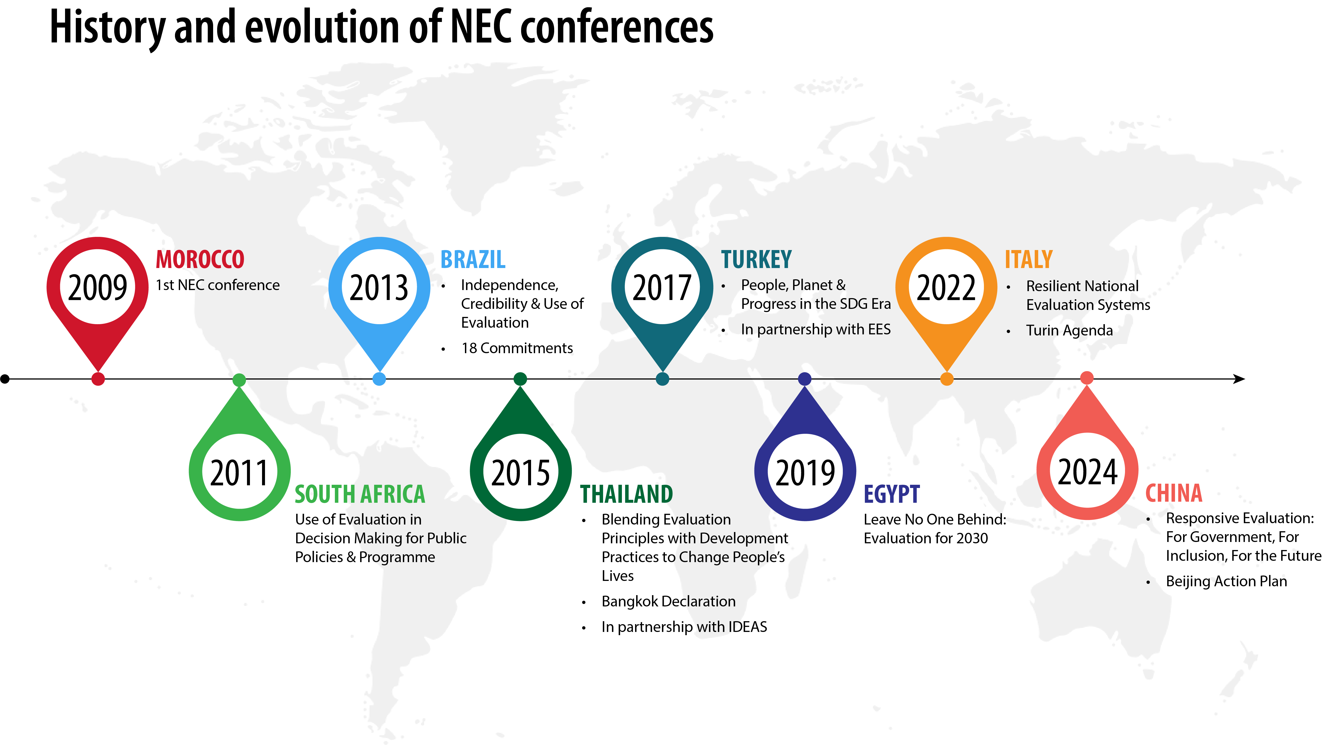
National Evaluation Capacity Conference
www.glocalevalweek.org

Slide 6
National Evaluation Capacity Conference
2000s
2010s
2020–
Professionalisation
Use for Better Development
Adaptation and Resilience
Small practitioner-led forum focused on capacity-building
Shift from evaluation technical practice to a tool of governance
Inclusion, participation and sustainability
Focus on methods & rigour
Ministerial & regional ownership
Digital tools & complexity approaches
Growing global participation
South–South exchange expands
Evaluation as a vital part of governance infrastructure
www.glocalevalweek.org
Notes:
Definition
Tool for good governance

Slide 7
National Evaluation Capacity
Action Point 1 : Embed country-led eval into public policy development and public sector management
Align national budget planning with evaluation recommendations and evidence-based priorities.
Position evaluation as a key accountability mechanism within government structures, ensuring oversight and aligning public spending with results.
Ensure evaluation tools, guidelines and policies developed to support this integration are aligned with SDG targets and indicators.
Integrate context and diverse perspectives that include women, marginalized populations and young people in evaluation processes
www.glocalevalweek.org
Notes:
Definition
Tool for good governance

Slide 8
National Evaluation Capacity
Action Point 2: Support a culture of learning and practice
Ensure evaluation plans and designs are aligned with the information needs of stakeholders.
Engage in capacity-building activities that empower intended users and decision makers throughout the evaluation process to create and use robust and relevant evaluation evidence.
Disseminate findings, encouraging peer learning across sectors and countries.
Ensure the buy-in of political leadership and integration of evaluation within the regular public policy process.
Facilitate formal and informal exchanges between commissioners and users of evaluation evidence at all levels of government.
www.glocalevalweek.org
Notes:
Definition
Tool for good governance

Slide 9
National Evaluation Capacity
Action 3: Share best practices and knowledge-sharing
Systematize the generation, application and exchange of insights from evaluation and other forms of evidence about how to accelerate the achievement of the SDGs, across governments.
Leverage syntheses of evaluations and other forms of evidence that promote learning from others around the world and an understanding of how these learnings vary by groups and contexts.
Ensure equal access to evaluation evidence and tools to support evidence production at country and regional levels.
www.glocalevalweek.org
Notes:
Definition
Tool for good governance

Slide 10
National Evaluation Capacity
Action 4: Use new and emerging technologies and capacities
Facilitate greater efficiencies in and effectiveness of evaluations by using AI, while balancing the ethical and legal imperatives to safeguard equity, data privacy and inclusivity for all.
Promote equitable access to AI technology to avoid deepening the Digital Divide.
Ensure the use of a people-centred and facts-based approach that embodies the values of equity, openness, responsibility, data security and country ownership.
Involve young evaluators in systems-strengthening efforts through targeted skills development, mentorship and their integration into the production and use of evaluations.
www.glocalevalweek.org
Notes:
Definition
Tool for good governance

Slide 11
National Evaluation Capacity
Action 5: Integrate resilience into evaluation
Strengthen adaptation in evaluation systems for timely crisis responses.
Incorporate inclusiveness and sustainability considerations across economic, social and environmental issues into evaluation evidence in all of its forms.
www.glocalevalweek.org
Notes:
Definition
Tool for good governance

Slide 12

global
evaluation
initiative
Thank you!
www.glocalevalweek.org

